Slide 1


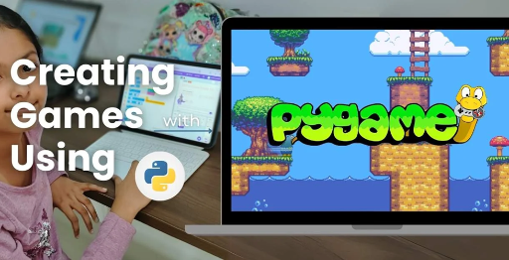
Session 7
Procedural Structure Generation

Slide 2
Learning Objectives
Understand game inspiration, install Pygame-CE, navigate project structure
Detailed Objectives:
Objectives:
Use the random and math modules to procedurally generate opponent defenses.
Create block towers or structures using tools.py.
Understand how randomization adds replayability.

Slide 3
Practical Tasks
Understand game inspiration, install Pygame-CE, navigate project structure
Below is the list of Practical Tasks:
Write a function in tools.py to generate a block structure (e.g., a tower of 5–10 blocks) with random positions and types.
Update Block class to support different block types (e.g., wood, stone) with varying health.
Render the generated structure on the screen during gameplay.
Test by generating and displaying multiple structures.

Slide 4
Deliverables
Understand game inspiration, install Pygame-CE, navigate project structure
Session Deliverables:
tools.py with a structure generation function.
A game screen showing a randomly generated block tower.
Tips:
Try different shapes for structures (e.g., pyramids, walls).
Share your structure designs with classmates for feedback.

Slide 5
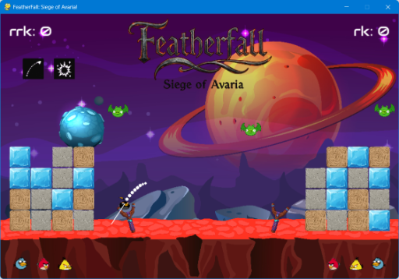
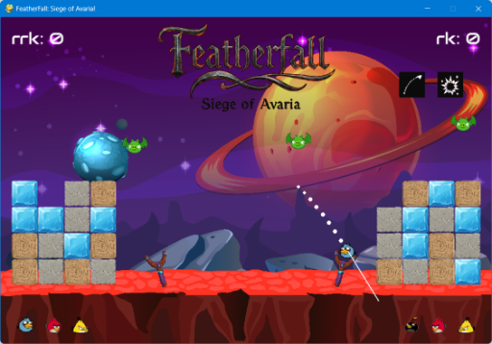
Procedural Structure Generation in PyGame
🏗️ Procedural Structure Generation in PyGame
👉 Using Python’s random & math modules to build dynamic, destructible towers in OMOGAME

Slide 6
Generating Structures with Python
🏗️ Generating Structures with Python
“Create Randomized Fortresses in PyGame with Code!” 👉 Kick off the session with the power of procedural generation for gameplay variation.
Kick off: Procedural generation for dynamic gameplay in OMOGAME: Siege of Avaria!
Inspired by Angry Birds, players destroy randomized fortresses.
Learn to use Python to generate varied block structures.
Focus: Create replayable, unique layouts with Pygame-CE.
Enhances strategic depth in two-player battles.

Slide 7
Why Procedural Generation?
🏗️ Why Procedural Generation?
Infinite layout combinations = high replayability
Makes every round of the game feel fresh
Saves time vs manually designing each level
📌 Used in games like Minecraft, Angry Birds, and Terraria!
Creates infinite layout combinations for high replayability.
Keeps each game round fresh and engaging.
Saves time compared to manual level design.
Used in games like Minecraft, Angry Birds, and Terraria.
Implemented in tools.py for Siege of Avaria!’s fortresses.
Encourages creative and unpredictable gameplay strategies.

Slide 8
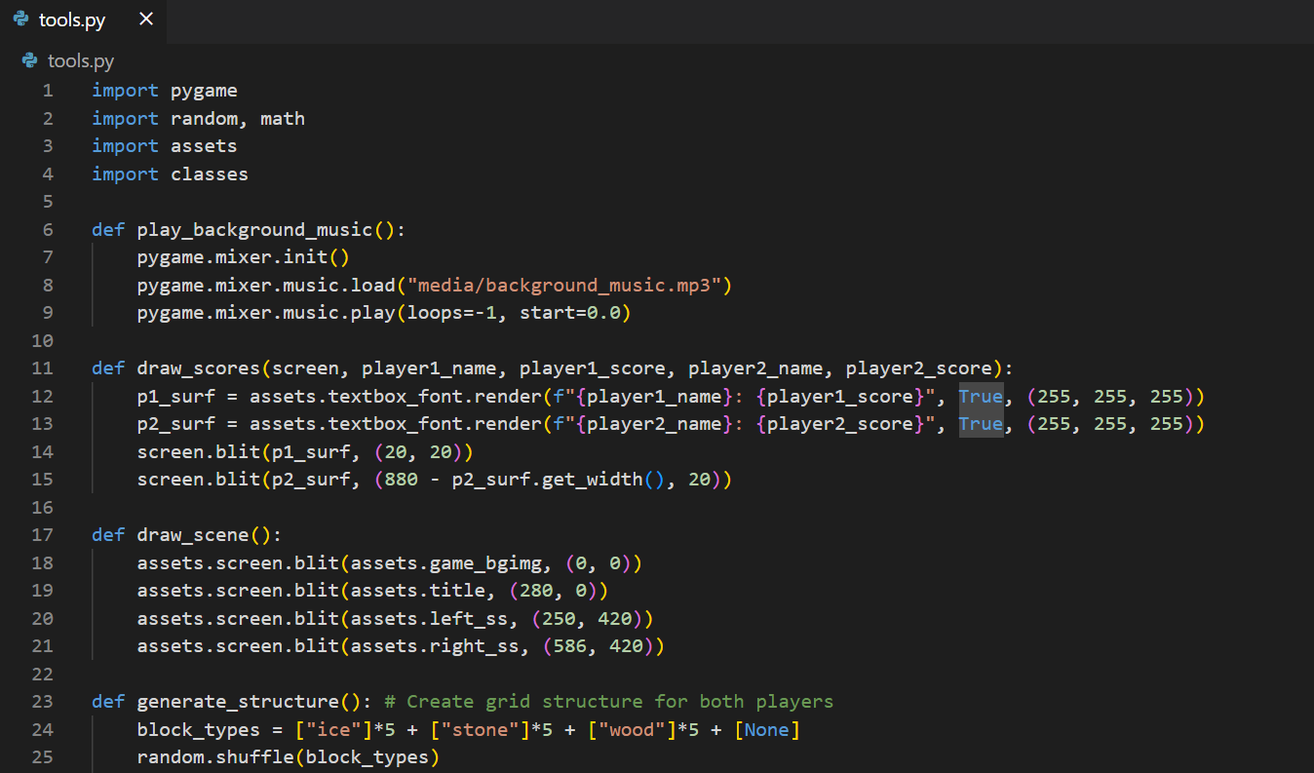
Why Procedural Generation?
CODE SNIPPET :

Slide 9
Tools We’ll Use
🏗️ Tools We’ll Use
👉 Using Python’s random & math modules to build dynamic, destructible towers in OMOGAME
Module Purpose
random Randomize block positions, types, heights
math Calculate spacing, angles, gravity effects
tools.py Where structure functions will be written
random: Randomizes block positions, types, and heights.
math: Calculates spacing, angles, and gravity effects for blocks.
tools.py: Contains structure generation functions.
classes.py: Defines Block class for structure properties.
assets.py: Loads block images from media/ for rendering.
Collaborative modules ensure dynamic fortress creation.

Slide 10
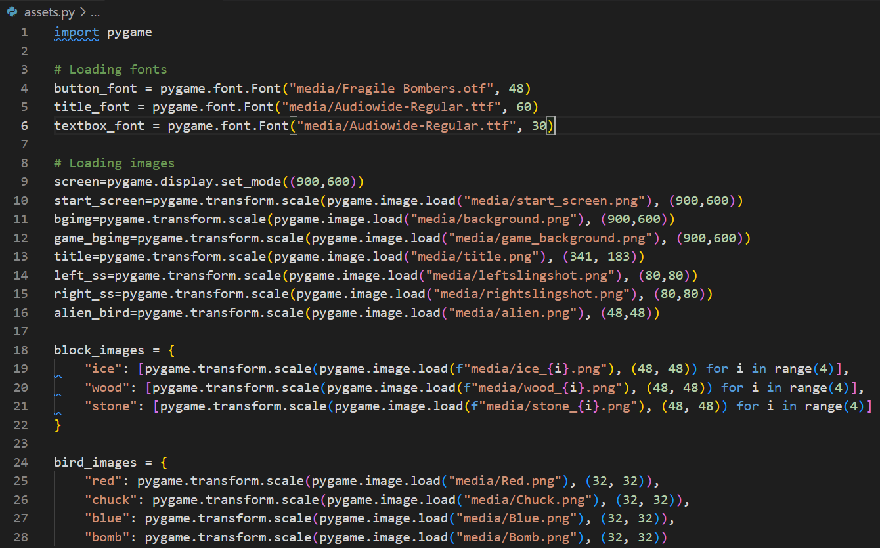
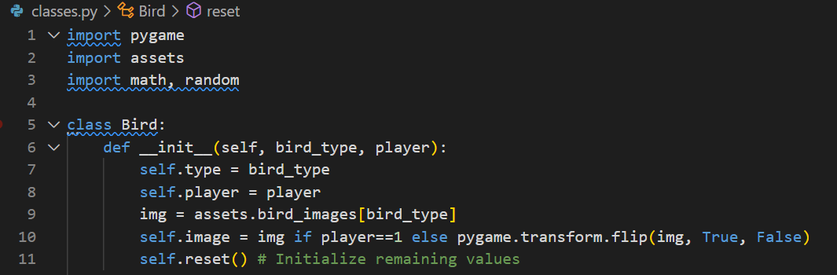
Tools We’ll Use
CODE SNIPPETs :

Slide 11
How Blocks Become Towers
🏗️ How Blocks Become Towers
👉 Define block shape, type, and position:
📦 Stack blocks vertically or arrange in shapes (L, T, Pyramid)
Define block shape, type, and position in tools.py:
for i in range(num_blocks):
x = random.randint(300, 600)
y = base_y - i * block_height
Stack blocks vertically or arrange in shapes (L, T, Pyramid).
Each block is a Block class instance with health.
Random placement enhances strategic challenge.
Supports varied fortress designs for both players.

Slide 12
Creating the Structure Generator
🏗️ Creating the Structure Generator
👉 In tools.py, write:
def generate_structure(start_x, base_y, block_count):
🧱 Each block = new object of Block class with health + material
In tools.py:
def generate_structure(start_x, base_y, block_count):
block_list = []
for i in range(block_count):
block_list.append(Block(type, x, y))
return block_list
Generates blocks with randomized positions and types.
Returns list of Block objects for rendering.
Called in game_modes.py for each player’s fortress.
Ensures varied layouts for Quick and Basic modes.

Slide 13
Support for Multiple Block Types
🏗️ Support for Multiple Block Types
👉 In classes.py, enhance Block with:
class Block:
🎨 Use assets.py to load different block images
Enhance Block class in classes.py:
class Block:
def __init__(self, type, x, y):
self.type = type
self.health = 50 if type == "wood" else 100
self.pos = (x, y)
Types: Wood (50 health), Stone (100 health).
Load images in assets.py: pygame.image.load("media/wood_block.png").
Visual distinction for block types enhances UI.
Health impacts gameplay in tools.py collision detection.

Slide 14
Display Your Structure
🏗️ Display Your Structure
👉 In main.py or game_modes.py:
Call generate_structure()
Loop through blocks & draw each one with screen.blit() 🎯 Test multiple builds with each run
In main.py or game_modes.py:
Call generate_structure() to create fortress.
Loop through blocks: screen.blit(block.image, block.pos).
Renders blocks using images from assets.py.
Test multiple builds to ensure randomization works.
Update each frame in game loop for dynamic visuals.
Integrates with tools.py for collision and damage handling.

Slide 15
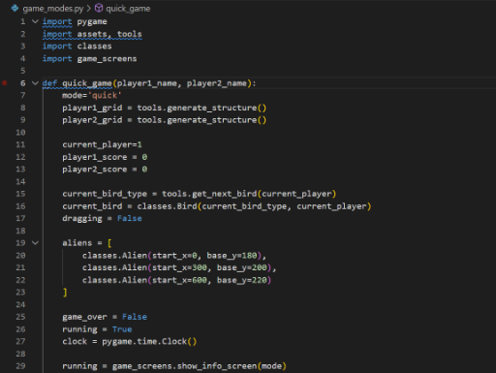
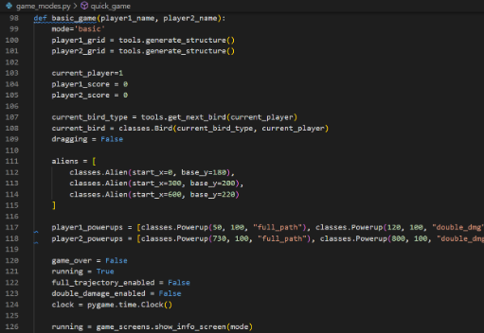
Display Your Structure
CODE SNIPPETs : GAME MODES

Slide 16
Student Experiment with Designs
🏗️ Student Experiment with Designs
👉 Student Creativity Time:
Shape ideas: Wall, L-shape, T-shape, Pyramid
Add block color-coding
Bonus: Add a “Structure Preview Mode” to your menu
Student creativity time:
Try shapes: Wall, L-shape, T-shape, Pyramid.
Add color-coding for block types (e.g., brown for wood, gray for stone).
Bonus: Add “Structure Preview Mode” in game_screens.py.
Modify tools.py to test different layouts.
Share unique fortress designs with team.
Experiment with block counts and patterns for variety.

Slide 17
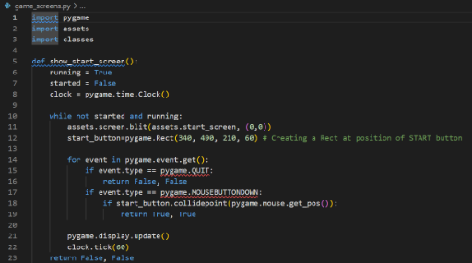
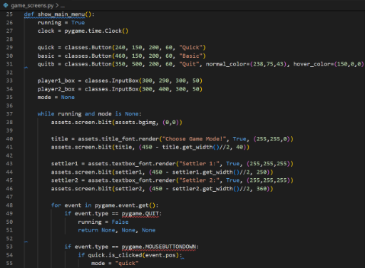
Student Experiment with Designs
CODE SNIPPETs : GAME SCREENS

Slide 18
Student Task – Build a Fortress Function
🏗️ Student Task – Build a Fortress Function
👉 Your Challenge:
Define a structure generator that:
Screenshot your structure in-game
🗂️ Deliver: tools.py, classes.py, background render
Challenge:
Create a structure generator in tools.py.
Randomize block count (5–15) and layout.
Use at least two block types (wood, stone).
Capture screenshot of in-game fortress.
Deliverables: Updated tools.py, classes.py, rendered background.
Save as: my_fortress_generator.py.
Submit for feedback on creativity and functionality.

Slide 19
Recap & Design Tips
🏗️ Recap & Design Tips
✔ You now understand:
💡 Tip: Use random.seed() during testing to lock a pattern for debugging
What you learned:
Procedural generation for dynamic fortresses.
Using random to spawn varied block layouts.
Visualizing towers with assets.py and tools.py.
Integrating structures into game loop.
Debugging tip: Use random.seed(42) to lock patterns for testing.
Reference: Pygame CE Documentation (https://pyga.me/docs/).

Slide 20

Exercise:
1. What is the primary objective of the Quick Mode in OMOGAME?
A) Collect all power-ups before the opponent
B) Launch birds without any destruction
C) Reach a score of 200 points
D) Complete the entire storyline
Answer: C) Reach a score of 200 points
2. Which file is considered the main entry point of the OMOGAME project? A) tools.py
B) main.py
C) assets.py
D) classes.py
Answer: B) main.py

Slide 21
Exercise..
3. What does the tools.py file mainly handle in the game?
A) Launching sound and animation
B) Player avatar selection
C) Collision detection and drawing functions
D) Managing game instructions
Answer: C) Collision detection and drawing functions
4. Which of the following is NOT listed as a unique feature of OMOGAME? A) Bird classes with special physics
B) Alien targets for bonus points
C) Multiplayer online matchmaking
D) Destructible block environments
Answer: C) Multiplayer online matchmaking

Slide 22
Exercise…
5. Why is organizing the OMOGAME project into files like classes.py, media/, and game_modes.py important?
A) It reduces the game’s memory usage
B) It helps reduce the number of bugs completely
C) It makes the project look colorful
D) It simplifies managing and updating different game parts
Answer: D) It simplifies managing and updating different game parts

Slide 23
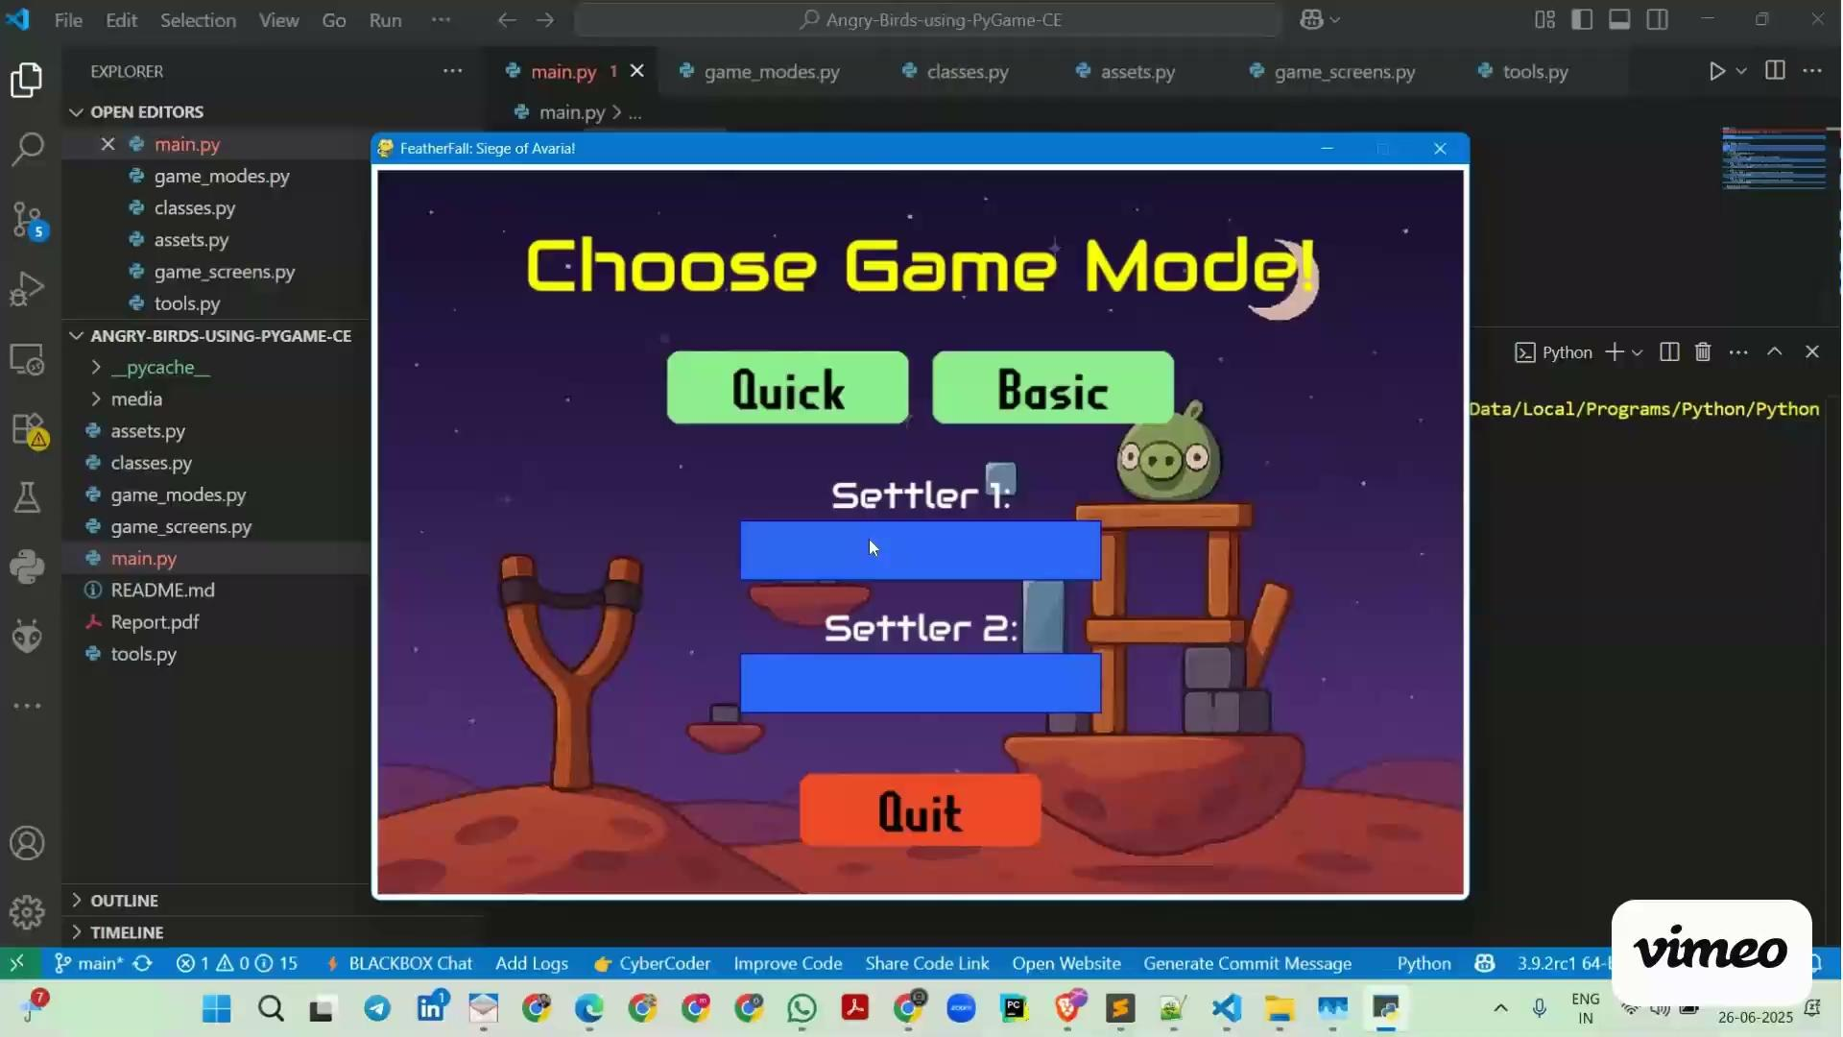
Session 7 VIDEO LINK
Procedural Structure Generation

